Slide 1


Women Fitness App –
Your Health and Wellness Companion
#Empower Your Fitness Journey with Care and Motivation

Slide 2


Concept Overview
Cycle Health Tracking
Fitness Progress Monitoring
Predict and track menstrual cycles with encouraging, game-like hints.
Track daily workouts and visualize progress.
Dietary Wellness
Motivational Wellness
Get practical, easy-to-follow daily diet tips.
Personalized goal-setting and achievement celebrations.

Slide 3
Cycle Health Tracking
Cycle Prediction
Tracking Prompts
Leverage machine learning to anticipate cycle patterns and provide personalized health insights.
Receive gentle reminders to log period and symptom data, gamifying the experience.

Slide 4
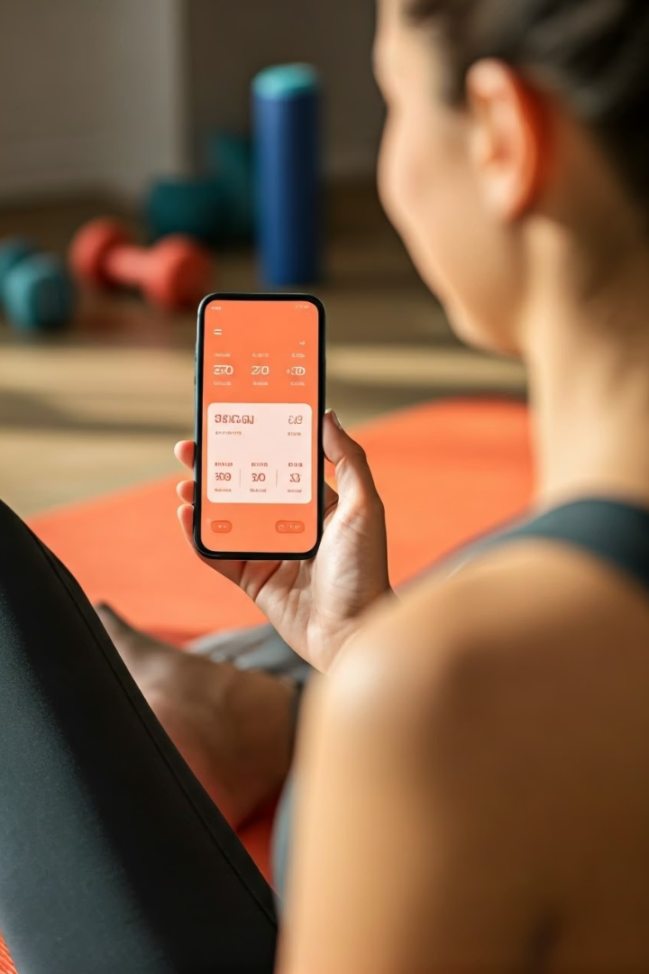
Fitness Progress Monitoring
Log Workouts
Record daily exercise routines and activity levels in the easy-to-use app interface.
Visualize Progress
See your fitness journey unfold through dynamic charts and graphs that motivate you to keep going.
Achieve Goals
Set personalized fitness objectives and celebrate milestones to stay inspired.

Slide 5


Dietary Wellness
Nutrient-Rich Recipes
Meal Planning
Grocery Lists
Generate personalized weekly meal plans with easy-to-follow instructions.
Automatically create shopping lists to make healthy eating a breeze.
Discover a library of tasty, nutritious meal ideas tailored to your preferences.

Slide 6




Motivational Wellness
Achievement Badges
Earn virtual rewards for completing challenges and reaching milestones.
Goal-Setting
Motivational Nudges
Personalize your fitness objectives and track progress towards them.
Receive encouraging messages and tips to stay consistent and motivated.

Slide 7
Holistic Well-being
Mindfulness
Sleep Tracking
Stress Management
Integrate guided meditations and breathing exercises to reduce stress and improve focus.
Monitor sleep patterns and get personalized tips for better rest and recovery.
Access expert-curated content to manage anxiety and enhance overall well-being.

Slide 8

Community Support
Accountability Partners
Expert Guidance
Connect with like-minded women to share progress, offer encouragement, and stay motivated.
Consult with certified fitness, nutrition, and wellness coaches for personalized advice.
Inspiring Stories
Read and share success stories to spark motivation and a sense of community.

Slide 9



Key Benefits
Empowered Fitness
Improved Health
Take control of your health and fitness with personalized tracking and guidance.
Cultivate better nutrition, mindfulness, and sleep habits for overall well-being.
Lasting Lifestyle Changes
Develop sustainable fitness and wellness routines with the support of the app and community.
BY
Dinesh Kumar – 2305A21L58
Sai Vikas – 2305A21L08
Hanmandlu – 2305A21L59
Darshan – 2305A21L57

